Slide 1



REDDIT POST – COMMENT RELEVANCE ANALYSIS
-EXPLORING THE NEXUS OF POSTS AND COMMENTS
Rajesh Kumar Reddy Avula
Sai Sindhura Kollepara
Shoukath Ali Shaik
Vineetha Maddikunta

Slide 2


CONTENTS
Problem Description
Data Description
Data Visualization
Preprocessing
Design Thinking Process
AI choice
Relevance Metric
Results
Future Direction

Slide 3
PROBLEM DESCRIPTION
Objective: To develop a method or tool to automate the assessment of comment relevance and similarity to posts.
Potential Impact: Enhancing user experience by promoting meaningful discussions, aiding moderators in identifying relevant comments efficiently.
Challenges: Reddit's vastness, Semantic Complexity, Spam and Irrelevant Content Detection.

Slide 4
ENVIRONMENT DETAILS
Python Version: 3.10.12
Operating System: Linux #1 SMP PREEMPT_DYNAMIC Sat Nov 18 15:31:17 UTC 2023
Machine: x86_64
CPU Cores: 1 Physical, 2 Logical
Total Memory: 12.67 GB
No GPU available.
name: "/device:CPU:0"
device_type: "CPU"
memory_limit: 268435456
Total Disk Space: 107.72 GB

Slide 5
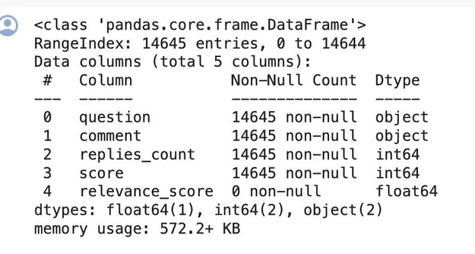
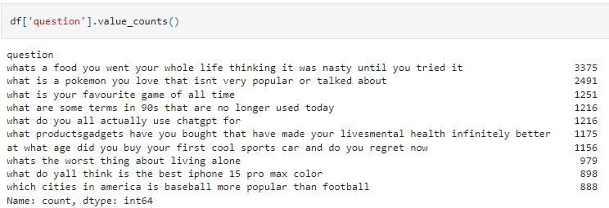
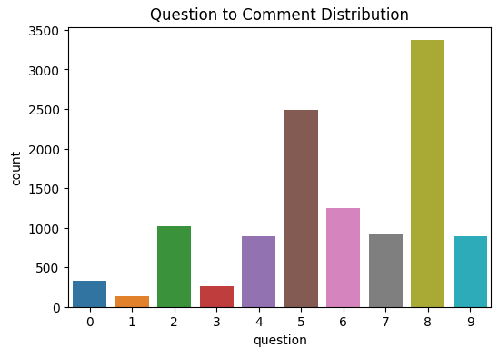
DATA DESCRIPTION
Relevance R﻿ating | Description
5 | Most Relevant
4 | Relevant
3 | Neutral
2 | Bad
1 | Terrible
Features collected from Reddit – Title, Comments, Score and Reply counts
Objective - Finding the Relevance Rating (on a scale of 1-5)

Slide 6
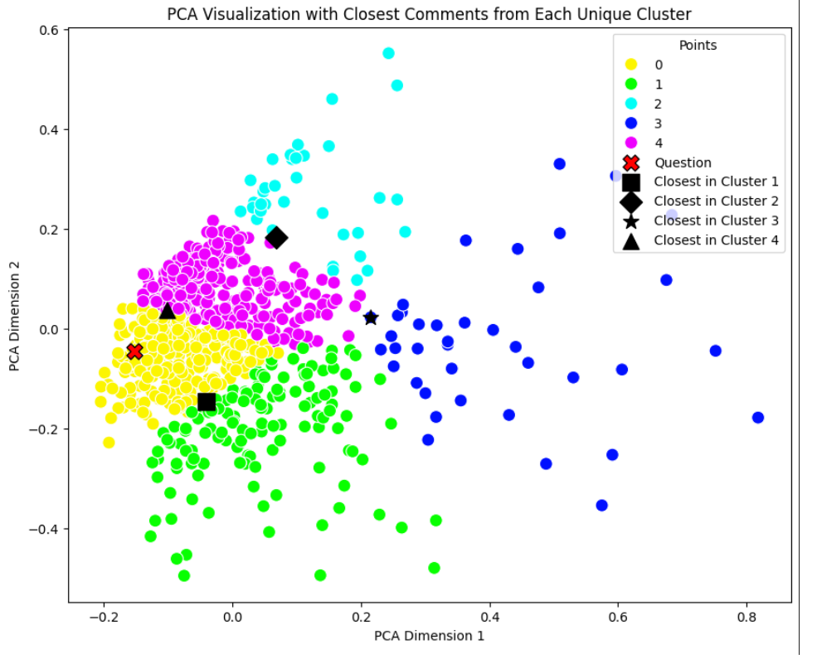
PREPROCESSING
Removing [deleted]/[removed] comments.
Text cleaning – Removing HTML tags, urls, special characters, emojis, etc.
Remove duplicate comments (spams).
Handling null values.
Applying tf-idf vectorization.

Slide 7
DESIGN THINKING PROCESS
Step 1: Embeddings to question & comments
Representing the questions and comments in numeric format
Step 2: Cluster the Embeddings
Step 3: Finding the Relevance of Entire Clusters
Ordering the clusters as per the relevance score calculated

Slide 8
AI CHOICE
Models for Embedding
Latent Dirichlet Allocation (LDA) - Topic Modelling
Pre-trained Sentence Transformers
GPT, BERT, BERT Quora, MiniLM
Neural Network (LSTM)
Hybrid Models
LDA + (BERT, BERT Quora, MiniLM, LSTM)
Clustering using KMeans

Slide 9
Relevance Metric
Creating a custom Relevance Metric including calculations of
User Engagement Factors - Score, Reply count
Cluster Coherence
Semantic Similarity
Comment Polarity
Applied weights to the above factors.

Slide 10
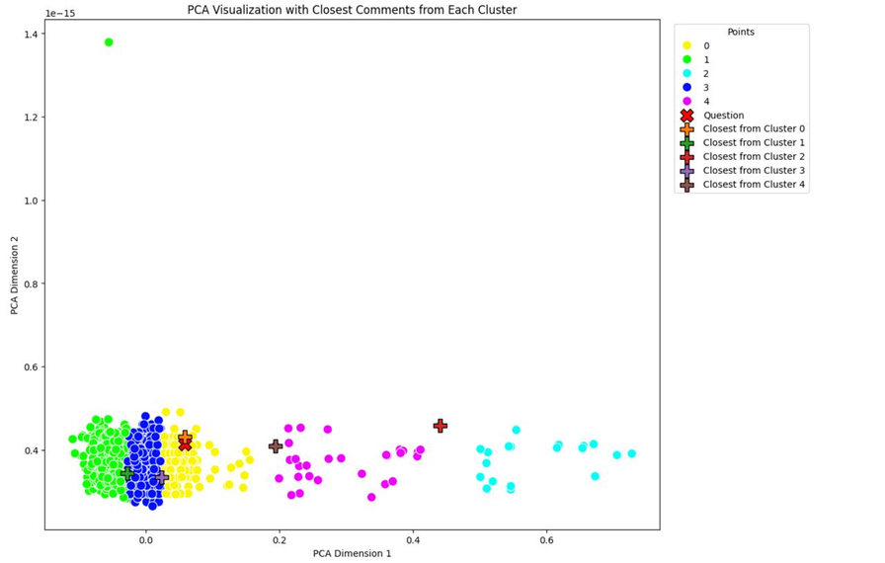
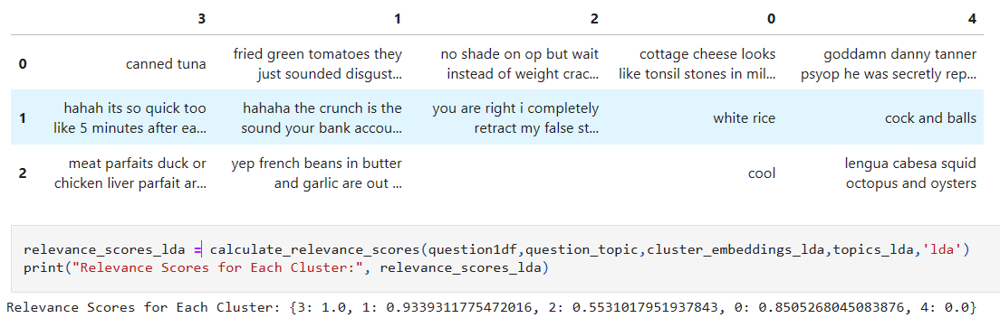
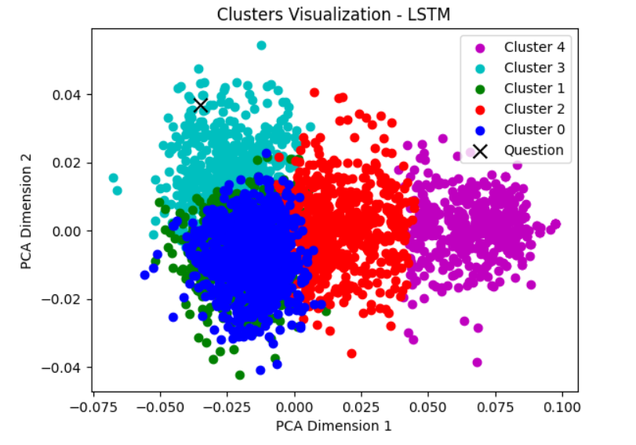
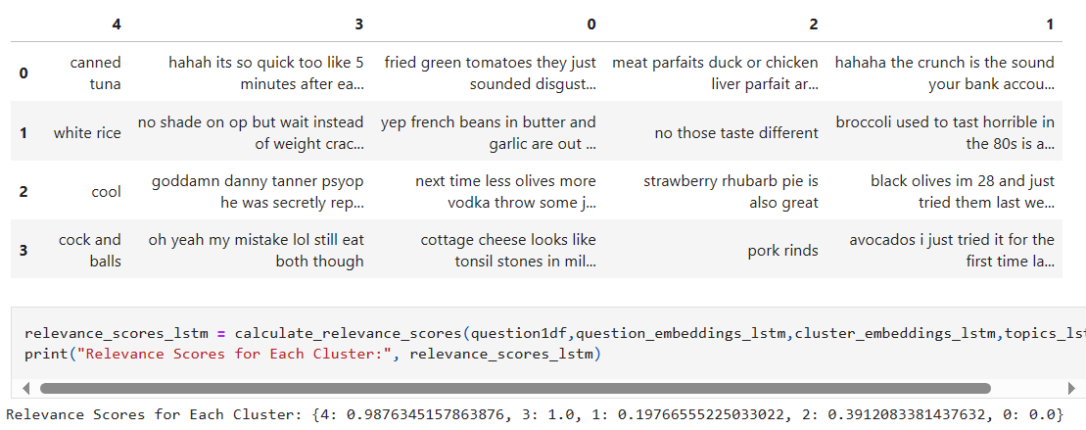
LDA & LSTM

Slide 11
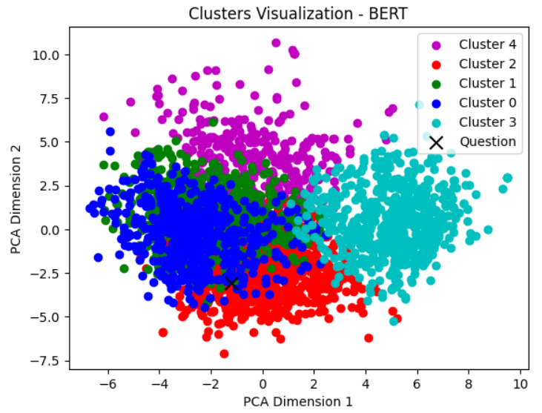
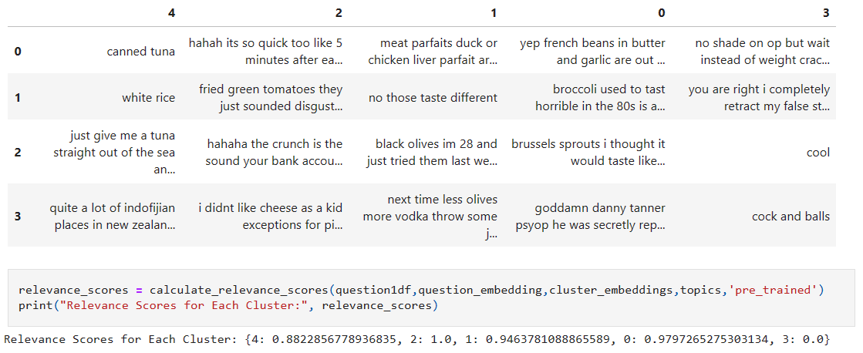
SENTENCE TRANSFORMERS

Slide 12
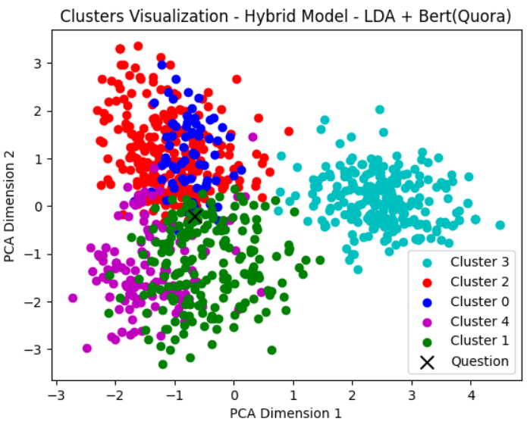
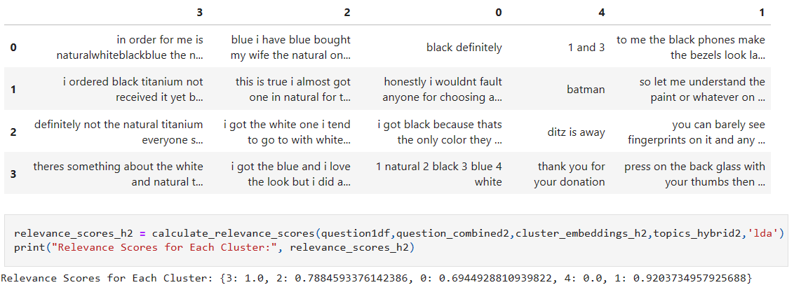
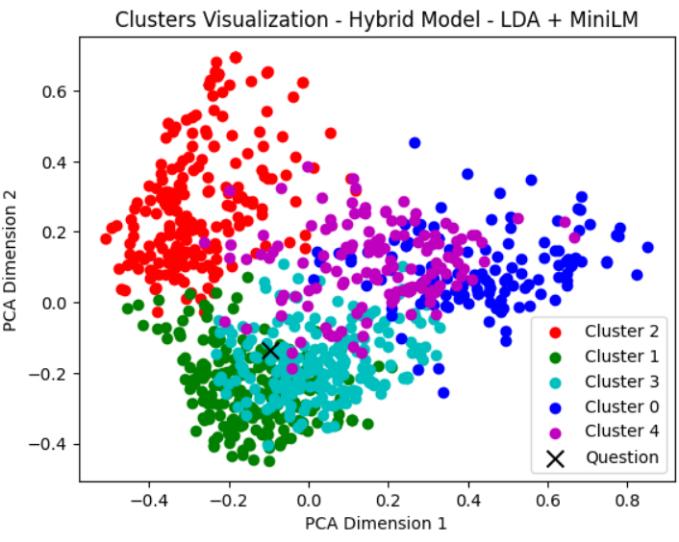
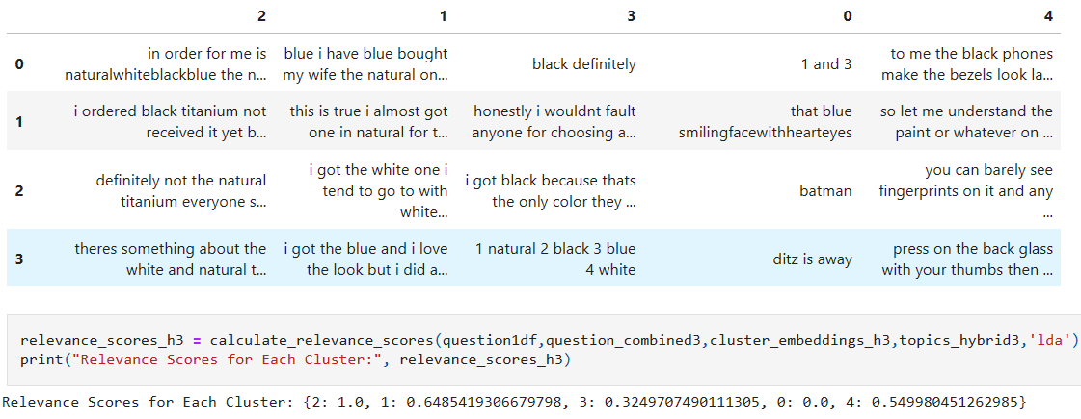
HYBRID MODELS

Slide 13
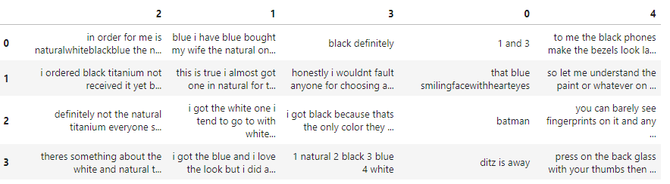
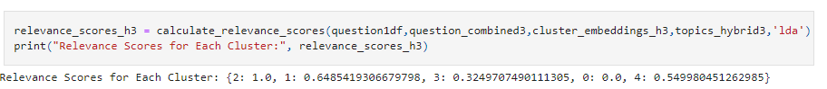
RESULTS
Final Model - LDA + MiniLM
Clusters:
Relevance Scores of clusters:

Slide 14
CHALLENGES & FUTURE DIRECTIONS
Challenges -
Shifted from Supervised to Unsupervised
Constructing a custom Relevance Metric
Evaluation Metric
Future Directions -
Multimodal Relevance Assessment
Further fine tuning
Enhancing efficiency of custom Relevance Metric

Slide 15

THANK YOU

